Slide 1
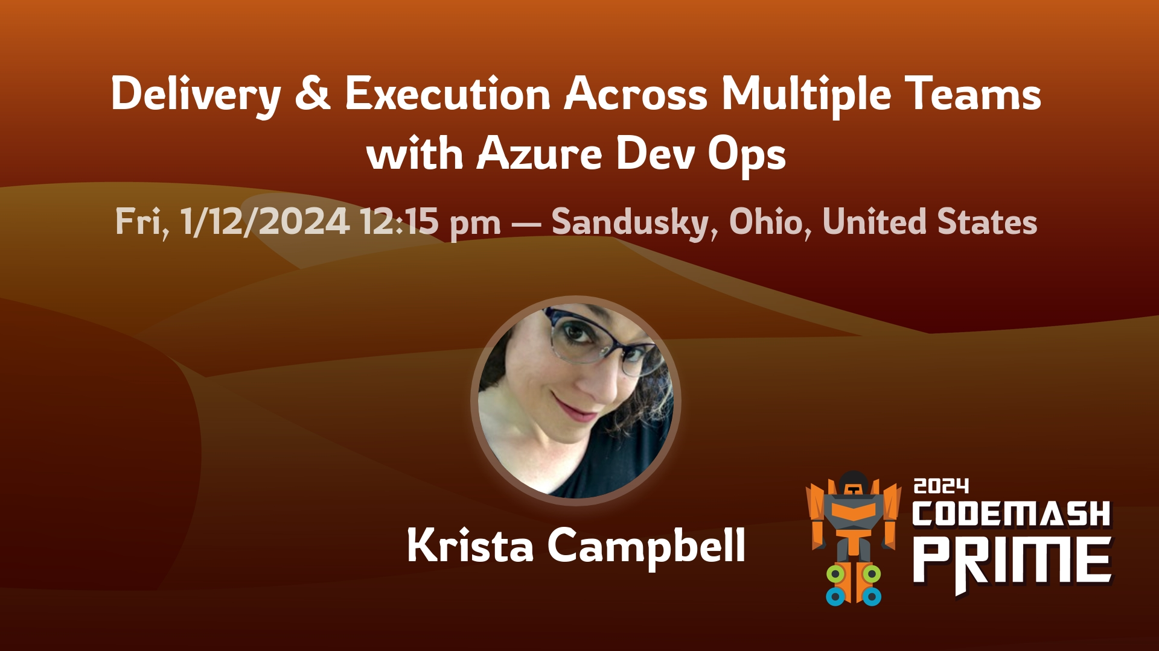

Slide 2


Krista Campbell
Architect. Technical Coach. Advocate. Musician. Mom. Transwoman. Human.
1st Program: BASIC on C64 to make sound effects. (4th grade)
Studied composition and computer science
I’ve been working with ADO since it was VS Team System 19 years ago!
Been doing this way too long!
Software Engineer, Tech Lead, Architect, Coach.
kristab3000@gmail.com

Slide 3
Topics
ADO Concepts
Summary of Tools & Techniques
One Project To Rule Them All - Shared Backlogs
Delivery Plans

Slide 4
Azure DevOps Concepts

Slide 5
Azure DevOps Concepts – What is ADO?
What is Azure DevOps or ADO ?
Accessible from Microsoft Azure but effectively its own product
ADO is Microsoft’s Application Lifecycle Management (ALM) Tool
Microsoft’s CI/CD platform
Microsoft’s Testing platform
Microsoft rebrands it every so often
Formerly Visual Studio Online
Formerly Microsoft Team Foundation Server
Formerly Microsoft Visual Studio Team System
For this talk we are focused on coordination, execution, and delivery of work via ADO which is primarily Azure Boards

Slide 6
Azure DevOps Concepts - Versions
Two Versions:
Azure DevOps Services – The Software as a Service offering
Regularly updated by MS with new features
Managed by Microsoft
Most widely used
Azure DevOps Server – The on-prem version
Requires internal IT support
Your company must install, configure, and support it
Updates must be applied manually
For the purposes of this talk we will be focusing on Azure DevOps Services

Slide 7
Azure DevOps Concepts – Key Entities
Organization
Top level Entity containing Projects
In on-prem & previous versions known as “Team Project Collections”
Changes at this level require Org Admin (top level) permissions
“Physical” boundary within which most Azure Boards functionality is contained
Best Practice: Use a single organization for all projects for your company.
All of the techniques discussed today assume we are in a single organization

Slide 8
Azure DevOps Concepts – Key Entities
Projects
Project is the central organizing concept of ADO
Projects are contained by Organizations
Each Project contains at least one team (but you can have more!)
Each project has a Work Item Template (Basic, Scrum, Agile, CMMI) which defines its behavior and naming of its work items
For purposes of this session we will be using the Agile WIT
Source repositories are also defined at the project level (GIT or TFVC)
Projects can also have their own project-level dashboards
Areas & Iterations are define at the project level (but used by teams – more on those in a bit!)

Slide 9
Azure DevOps Concepts – Key Entities
Teams
Teams consist of a collection of users and a backlog of work
The work can be viewed in one of several hierarchical backlogs
The work can also be viewed as a “Kanban Board”
(Microsoft calls any board of work items a “Kanban Board” even if the team isn’t practicing Kanban. We will just call them “boards” from here on
Backlogs and Boards are just different views of the same data
Teams can customize their own boards
Teams can also visualize their work, KPIs and other helpful info with Dashboards
Backlogs are specialized versions of Work Item Queries

Slide 10
Azure DevOps Concepts – Key Entities
Iteration Paths = Sprints
Iteration Paths are the central unit of defining time blocks in ADO
They are more commonly called Sprints, and within ADO, they are used interchangeably
Every Work item in ADO has an Iteration Path – representing either a sprint or the team’s backlog
Each Team typically has its own set of Iteration Paths (although they can be shared across teams)

Slide 11
Azure DevOps Concepts – Key Entities
Area Paths = Team Ownership (kind of)
Every work item in ADO has an area path
In the simplest case, each Team has its own base area path.
All work items on or below that path are owned by the team
So work items which are assigned that area path show up in the team’s backlog and on the teams boards
However it’s possible for multiple teams to share area paths or parts of an area path.
We will get to this case later as it can be used for managing multiple teams

Slide 12
Azure DevOps Concepts – Key Entities
Work Items
Work Items are the key units of work in ADO
The work items available in a project/team are dependent upon the Work Item Template used to define the team when it was created.
We are using the Agile WIT for this session which consists of
Epics – Initiative level groupings of features owned by team or managers
Features – Groupings of user stories owned by team or managers
User Stories – Central unit of work for a team
Tasks – Primary unit of effort. Remaining work is tracked here.
Highly customizable – from adding custom fields to existing work item types to defining new custom types and backlog levels

Slide 13
Azure DevOps Concepts – Work Item Links
Work Items can be related via work item links
The most common link is Parent/Child
Such as Epic -> Feature
Feature -> User Story
User Story -> Task
For delivery and execution purposes, the predecessor/successor link is key (more on this later)

Slide 14
Azure DevOps Concepts – Self Service
Best way to learn ADO is to play with it yourself & it’s available for free (for projects under 5 users)
https://learn.microsoft.com/en-us/azure/devops/user-guide/sign-up-invite-teammates?view=azure-devops&tabs=microsoft-account
This will create an ADO organization for your Microsoft account.
Pleeeeeze don’t create actual work in your organization – for that your IT department should create an ADO organization for your entire company – projects and work items are NOT easily movable across ADO organizations.

Slide 15
Summary of Techniques

Slide 16
Summary of Techniques – Using ADO Essentials
One Project To Rule Them All – Shared Backlogs
In this scenario a single project with multiple teams is used
Hierarchical area path are created corresponding to a cross project management view, management teams, and development or feature teams
Shared Backlogs can be used to plan, execute, and deliver work across teams
Will cover this technique in more detail later

Slide 17
Summary of Techniques – Using ADO Essentials
Work Item Queries (WIQs)
Work item queries are a very powerful way to query information
Especially recursive information based on a link type such as parent/child or predecessor/successor
Backlog views are actually just WIQs with extra functionality
WIQs do provide the ability to query across projects, but it is limited in that it cannot traverse work item links across projects
Dashboard widgets
Widgets can offer powerful out of the box visualization work items
The more complex widgets are built on WIQs
However they share the same limitations as WIQs and can’t traverse projects

Slide 18
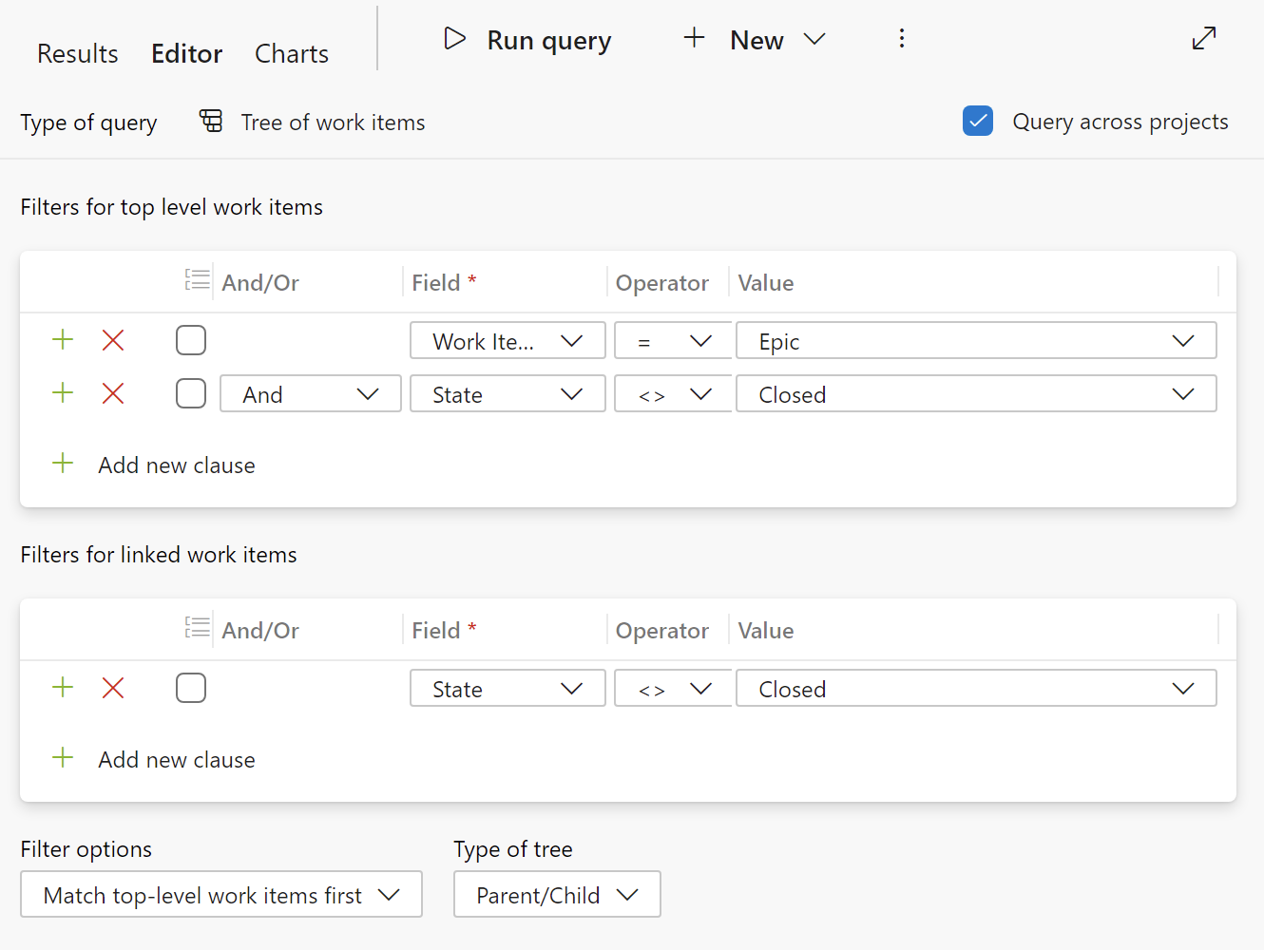
Summary of Techniques – Using ADO Essentials
A simple query to list all open work items hierarchically starting with Epics in an organization
But doesn’t capture relationships across projects

Slide 19
Summary of Techniques – Delivery Plans
Delivery Plans
Started as an ADO extension which was eventually included as a fully-support feature in ADO itself
Provide the ability to plan, execute, and deliver work across multiple teams within any project in the organization.
Most adaptable and flexible means to plan cross team/project work as they do not require a complex project/team backlog structure and support heterogeneous project types and structures
Delivery Plans beat-out other competing extensions Epic Roadmaps, Feature Timelines, and Portfolio Plans
More on Delivery Plans below!

Slide 20
Summary of Techniques – Reporting
Analytics Views
Project specific simplified views of team and project data
Intended to be (relatively) easily consumable by Power BI (free)
Create your view in Azure Boards, then consume that view in Power BI
See https://learn.microsoft.com/en-us/azure/devops/report/powerbi/what-are-analytics-views?view=azure-devops for more details
It is possible to create Power BI Reports across projects by using multiple analytics view which can be very inefficient for larger projects

Slide 21
Summary of Techniques – Reporting
OData queries
More complexity but more to write than Analytics Views
Exposes the entirety of ADO’s historical data
Possible to query across multiple projects in a single query
This is the modern, Azure DevOp Services analog to the old on-prem Azure DevOps Server SQL Reporting Services
Analytics views are effectively a de-normalized flattened version of the data exposed via Analytics Views
For more information: https://learn.microsoft.com/en-us/azure/devops/report/analytics/entity-reference-general?view=azure-devops

Slide 22
Summary of Techniques – Extensions
Microsoft DevLabs and 3rd Party Vendors are constantly building new extensions to ADO
These are all visible via the ADO Marketplace: https://marketplace.visualstudio.com/azuredevops
Extensions have to be installed by an ADO Organization Admin and then enabled for your project.
Note: extensions come and go. You want to make sure you pick something that is still being actively supported.
Microsoft DevLabs is generally a safe bet.
Their best extensions eventually become part of ADO

Slide 23
Summary of Techniques – Extensions
Portfolio++ from iTrellis
Both free and paid versions available
Allows for visualization of cross-project roadmaps similar to Delivery Plans
For more information see: https://marketplace.visualstudio.com/items?itemName=itrellis.portfolio-plus-plus
Planner Extension from Innotech Strategies
License fee required
Calendar view for viewing/scheduling work items
Negative reviews/installation issues
For more information see: https://marketplace.visualstudio.com/items?itemName=InnotechStrategies.custom-planner
Recommendation: Use Delivery Plans first, then look at other extensions only if Delivery Plans doesn’t meet your needs.

Slide 24
Summary of Techniques – Deprecated
Deprecated Extensions
Included here as they have deprecated only in the past year and are still present on some installations
Feature Timeline – provided a tea-level view of feature progress across sprints
Epic Roadmap – provided a cross team view of epics and their component work items
Portfolio Plans – similar to delivery plans – provided a cross project view of work.
Recommendation: If these extensions are still installed on your ADO organization, do not use these extensions, but instead use Delivery Plans

Slide 25
Summary of Techniques – Deprecated
SQL Server Reporting
Advanced reporting via SQL Server Reporting Services used to be the only way to mine multi-project data
However, that was available only on Azure DevOps Server and has been deprecated as of Azure Dev Ops server 2020

Slide 26
One Project to Rule Them All:
Shared Backlogs

Slide 27
One Project to Rule Them All - Shared Backlogs
One Project to Rule Them All
This is generally the recommended approach by Microsoft to configure for work multiple teams with or without shared backlogs
It provides the greatest flexibility in visibility and sharing of work items across teams.
Shared backlogs (or “Portfolio Management”) allow us to take advantage of this to have a common backlog and view of work at the high level (typically for project managers) but also allowing teams doing the work to be autonomous
Until recently this was the only means to roll up work in multiple teams into a single high level view

Slide 28
One Project to Rule Them All - Shared Backlogs
Pros:
Leverages ADO structure
Provides the greatest flexibility in tool usage as all work items are in the same project
Cons:
Complicated to setup and maintain
Requires shared area paths which can cause issues if Azure boards are customized
Requires that the project and team structure is known and defined ahead of time.
Requires that all teams exist in the same project – and thus have the same work item template.

Slide 29
One Project to Rule Them All - Shared Backlogs
Approach:
The key to the approach is using a hierarchical area path structure
Remember that a backlog is just a collection of work items in an area path
And a team’s backlog is defined by associating that team with said area path
A common area path is created for the default team of the project
Below that common area path, management area paths are created for management teams
High level work items like Epics and Features exist in these area paths
Below those management area paths, area paths are created for development teams (which Microsoft likes to call Feature Teams)
User Stories and Tasks to implement the Epics and Features exist at this level

Slide 30
One Project to Rule Them All - Shared Backlogs
The canonical Microsft Fabrikam Fiber example can be found here: https://learn.microsoft.com/en-us/azure/devops/boards/plans/portfolio-management?view=azure-devops

Slide 31
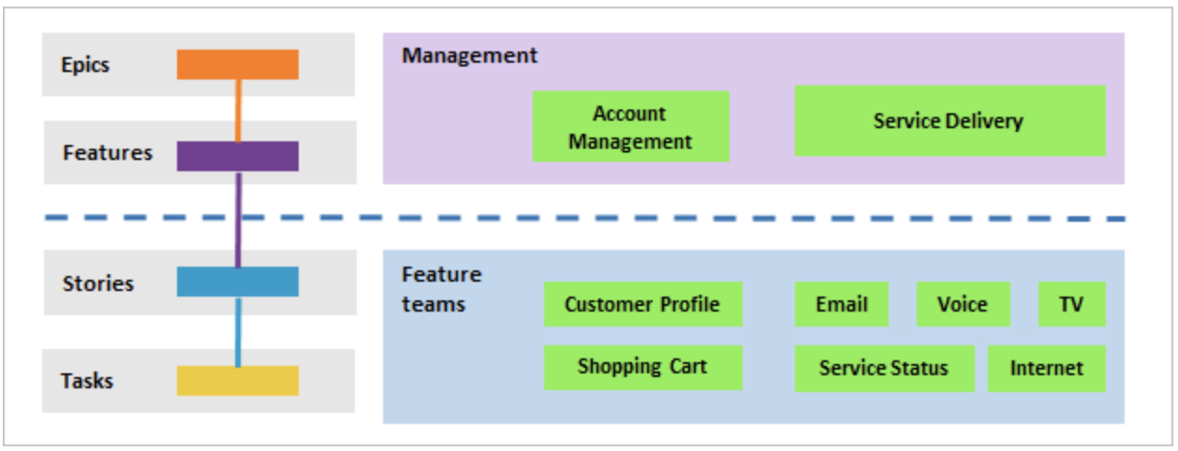
One Project to Rule Them All - Shared Backlogs
Account Management & Service Delivery teams are management teams owning Epics and Features

Slide 32
One Project to Rule Them All - Shared Backlogs
Customer Profile, Shopping Cart, Email, Voice, TV, Service Status,and Internet are all development (feature) teams owning user stores and tasks

Slide 33
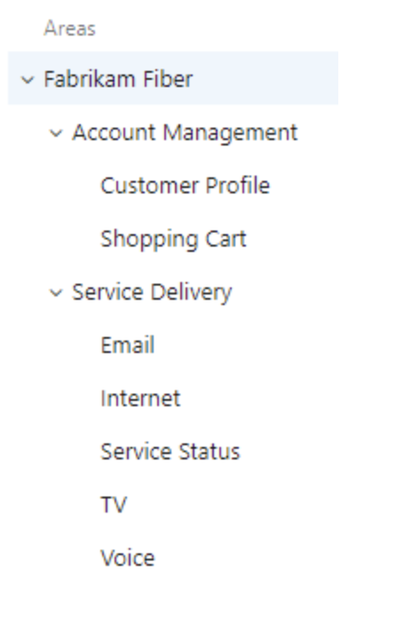
One Project to Rule Them All - Shared Backlogs
The hierarchical area path structure required to implement these backlogs is as follows:
Teams are defined which correspond to each of these area paths, with a Management team defined at the highest level

Slide 34
One Project to Rule Them All - Shared Backlogs
Then backlog views for each team can be used to show only the work that belongs to them.
Note that you have to add a “NodeName” columns to show the team names
You also have to be a member of each of the teams to be able to see their work items in the backlog

Slide 35
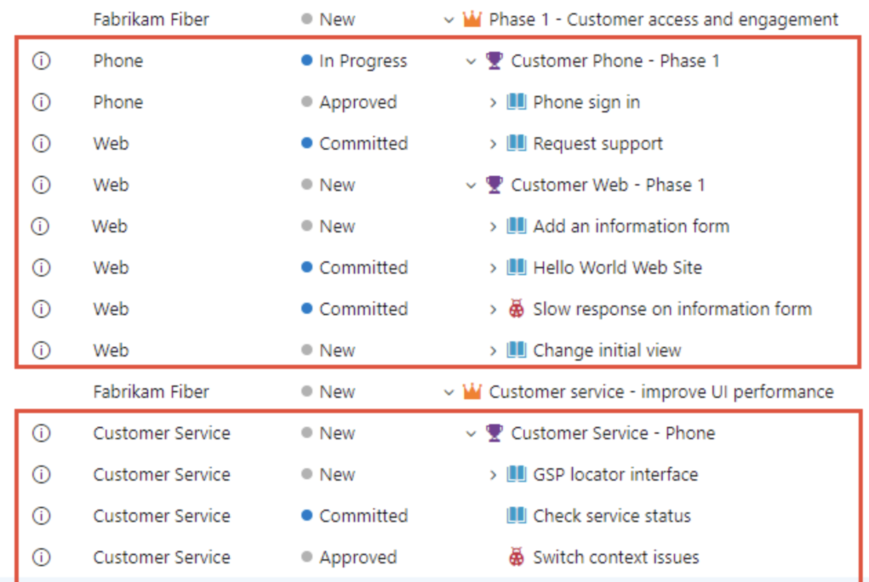
One Project to Rule Them All - Shared Backlogs
Management View

Slide 36
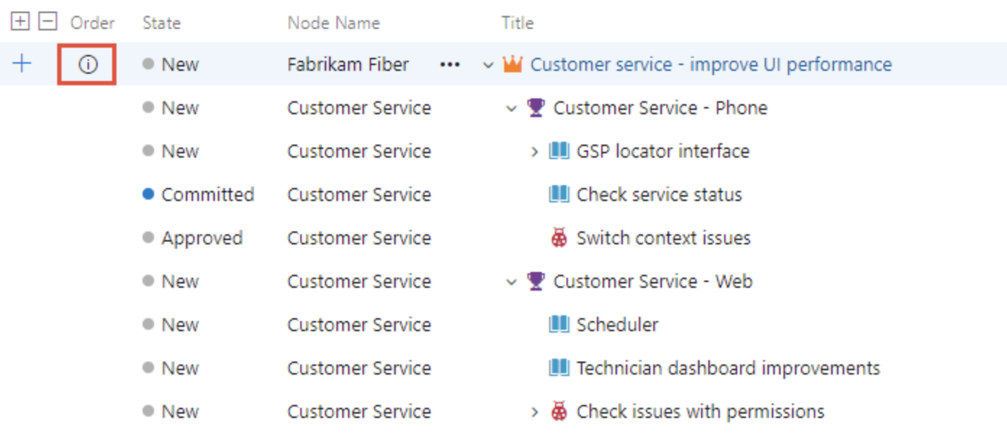
One Project to Rule Them All - Shared Backlogs
Customer Service View
Note that the Fabrikam Epic is visible only with “Show Parents” enabled
The ‘i’ shows that its from a different team

Slide 37
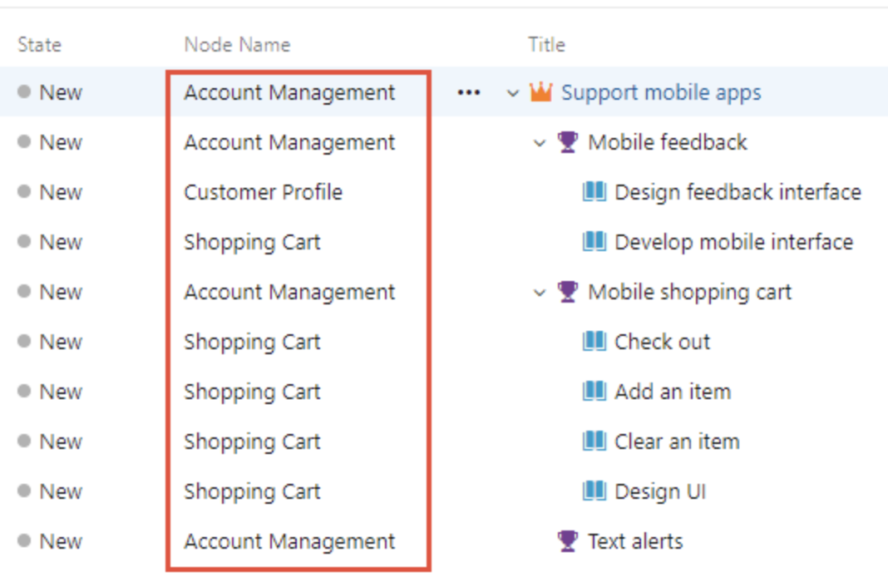
One Project to Rule Them All - Shared Backlogs
Account Management View

Slide 38
Delivery Plans

Slide 39
Delivery Plans
Of all the techniques used thus far, Delivery Plans offer the greatest functionality, simplicity of use, and flexibility
Work Items from any team in the entire organization can be included.
This allows for cross-project and cross-team planning & delivery to be done without having to define a complex and static project/team structure as we saw in Shared Backlogs
Work can be added from any backlog level for a team
Sprints do not have to match across teams
The “Winner” of the extension battle between Feature Timelines, Epic Roadmaps, and Portfolio plans.
And it is now available freely as core functionality of ADO

Slide 40
Delivery Plans
Summary of Delivery Plan Features:
View up to 20 team backlogs, including a mix of backlogs and teams from different projects.
View work items that span several iterations
View rollup progress of features, epics, and other portfolio items
View dependencies that exist between work items
Most items on the plan can be collapsed, expanded, or drilled down
Editing items on the plan edits the work item itself
Includes the creation of new work items
The most common edit is changing the Start & Target dates of a work item.

Slide 41
Delivery Plans – Delivery Plan Requirements
To ensure the required work items are visible on the plan:
Work items must belong to a team's product backlog (Stories, Tasks) or portfolio backlog (Epics, Features)
Sprints must be selected for each team defined in the plan.
Start and end dates must be defined for each iteration.
Iteration paths must be assigned to each work item.
For dependency icons and lines to show, work items must be linked via the Predecessor-Successor link type
It’s common to miss one of these, especially when creating a new delivery plan. Come back here if you’re asking yourself “Where’s my stuff?”

Slide 42
Delivery Plan Creation
A delivery plan is created from the Delivery Plans node in the Azure Boards Hub
When creating the plan, you add work to it by selecting any team in the organization (even external to the current project)
And from that team you select a backlog (e.g. Epics, Features, Stories)
You can further filter which work items appear on the delivery plan by defining Field Criteria, much like a work item query

Slide 43
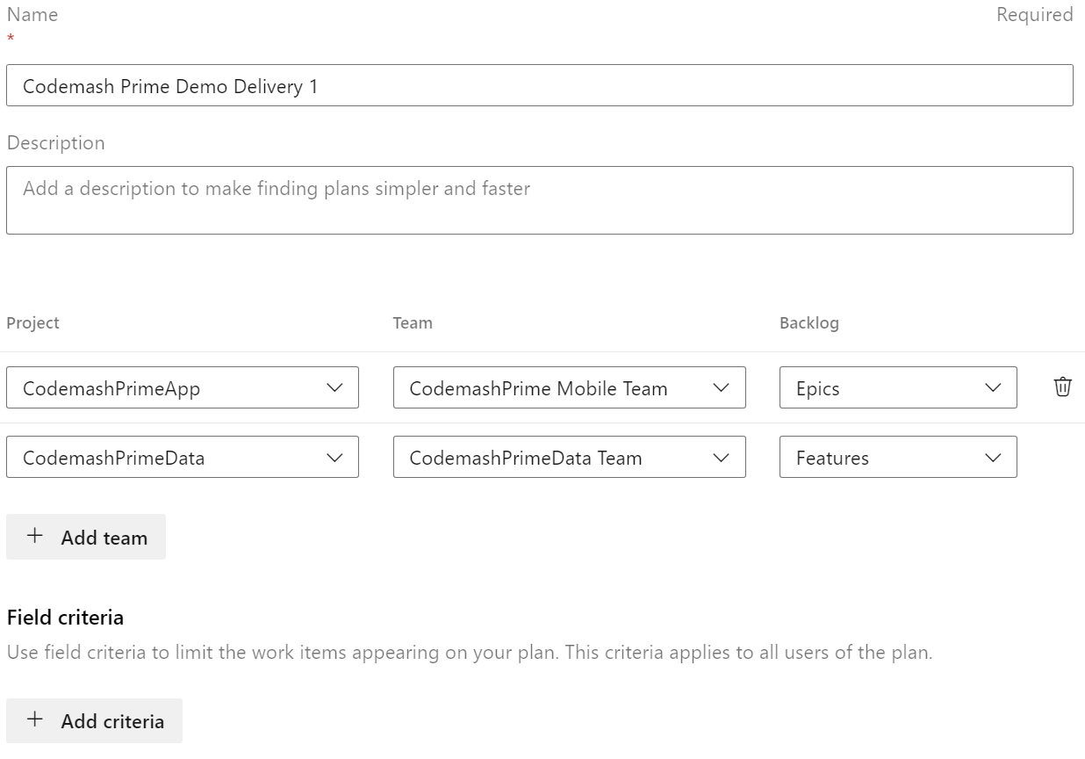
Delivery Plan Creation
Here the epics backlog is added from one team and the features backlog is added from a different team in a different project.

Slide 44
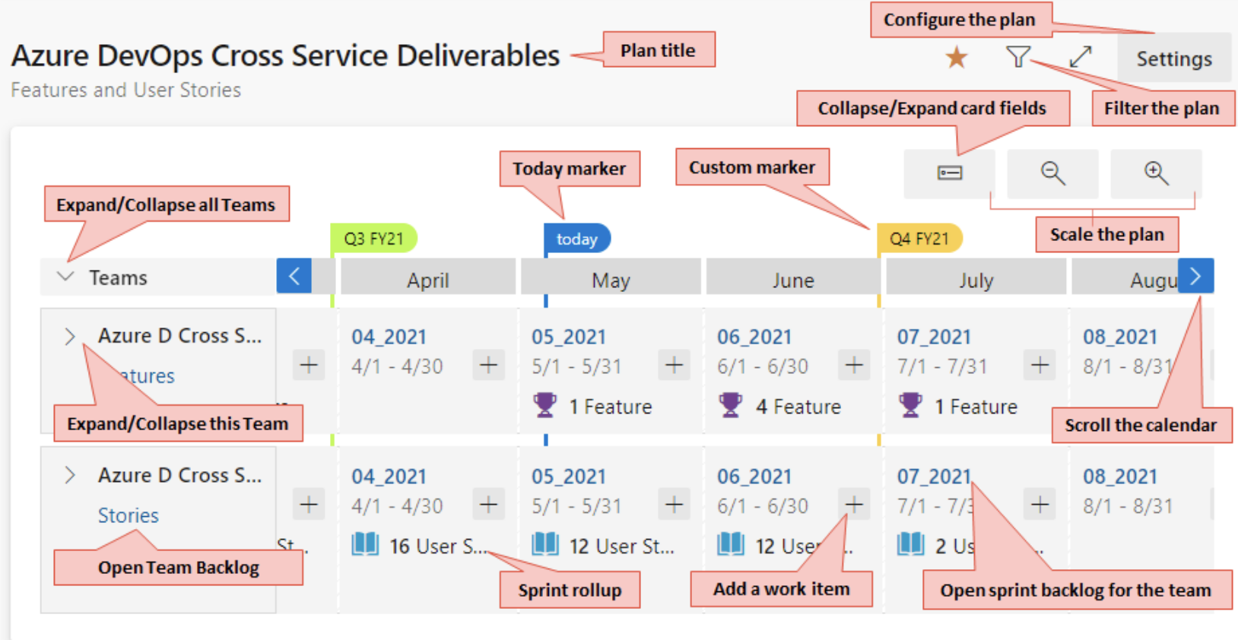
Delivery Plans – Essential Functionality

Slide 45
Delivery Plans – Dependency Tracking
Dependency Tracking is one of the most important aspects of coordinating work across multiple projects/teams
This is one of the key functions of Delivery Plans
Based entirely on predecessor/successor work item links
Work items can be linked of any type.
They simply have to meet the criteria to be viewed on the Delivery Plan (See Delivery Plan Requirements above)

Slide 46
Delivery Plans – Dependency Tracking
Dependency Tracking is one of the most important aspects of coordinating work across multiple projects/teams
This is one of the key functions of Delivery Plans
Based entirely on predecessor/successor work item links
Work items can be linked of any type
They simply have to meet the criteria to be viewed on the Delivery Plan (See Delivery Plan Requirements above)

Slide 47
Delivery Plans – Dependency Tracking
Invalid dependencies occur when a successor work item ends before its predecessor ends.
End dates can be defined in one of two ways:
By the Target date field (if defined)
Otherwise, by the end date of the sprint (iteration) currently assigned to the work item.

Slide 48
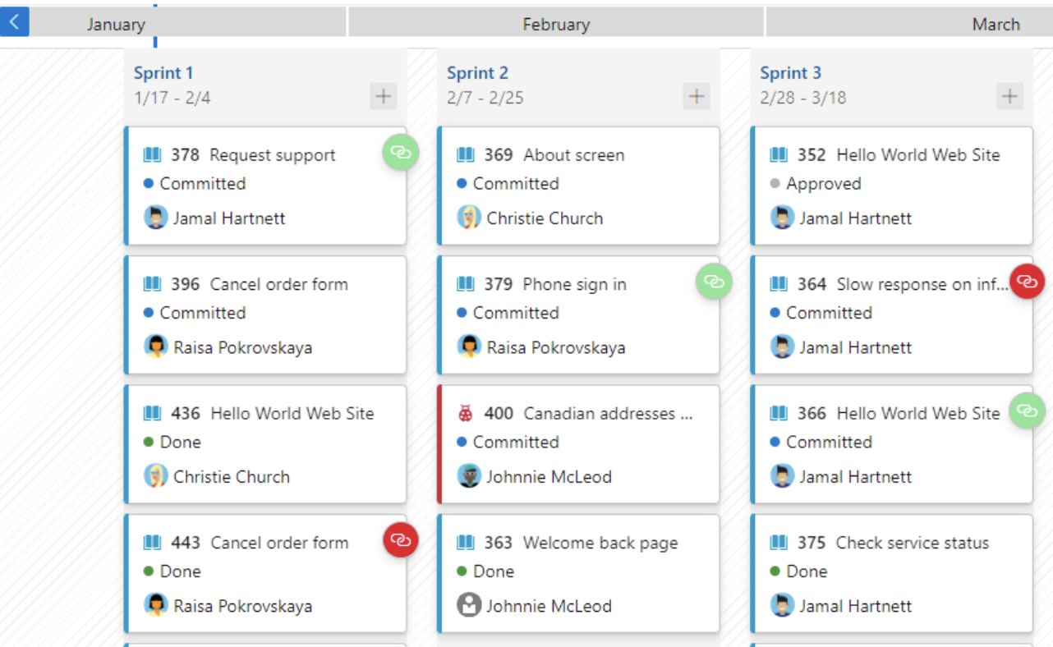
Delivery Plans – Dependency Tracking
Valid Dependencies are shown with a green link icon
Invalid Dependencies are shown with a red link icon

Slide 49
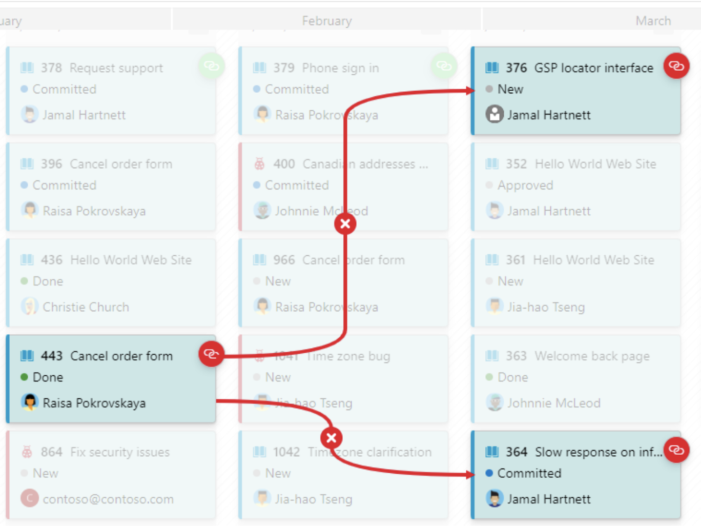
Delivery Plans – Dependency Tracking
Clicking on a card will show its dependencies

Slide 50
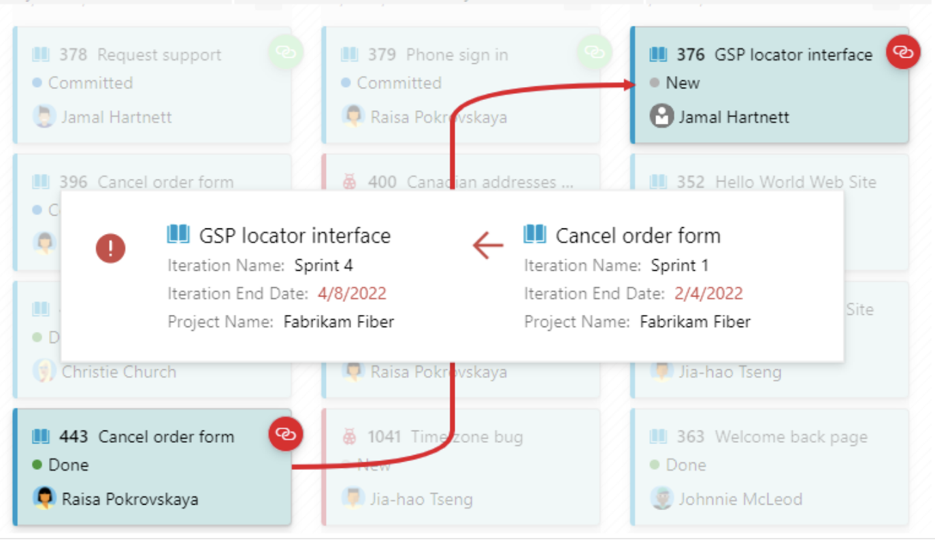
Delivery Plans – Dependency Tracking
Clicking on the X will show the reason for the invalid dependency

Slide 51
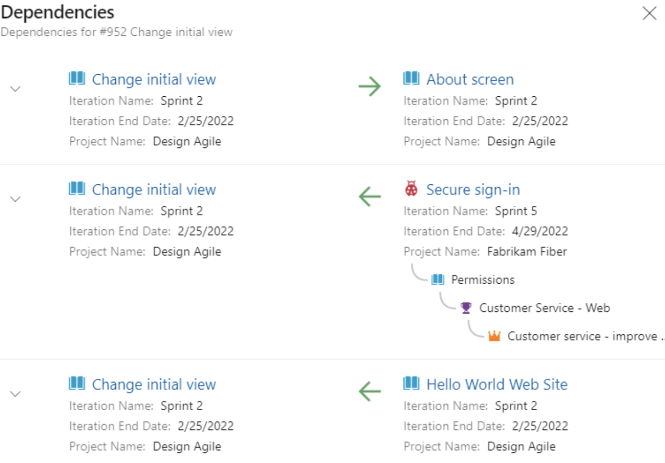
Delivery Plans – Dependency Tracking
Clicking on the link icon on a work item will display all dependencies for that work item

Slide 52
Delivery Plans
For more information, see: https://learn.microsoft.com/en-us/azure/devops/boards/plans/review-team-plans?view=azure-devops
And: https://learn.microsoft.com/en-us/azure/devops/boards/plans/track-dependencies?view=azure-devops

Slide 53
Delivery Plan Demo
CodemashPrime App Project– Owns the CodemashPrime mobile app consisting of 3 teams
All teams have matching 2 week sprints
All teams use Epic, Feature, and Story backlogs
Teams: CodemashPrime Mobile, CodemashPrime UX, CodemashPrime BackEnd
CodemashPrime Data Project – Owns CodemashPrime databases
Only uses Features and Story backlogs
Only has 1 default team
2 week sprints matching CodemashPrime App
CodemashPrime Integration Project – Owns integration with all vendor systems
Uses Epic, Feature, and Story backlogs
Only has 1 default team
3 week sprints

Slide 54
Thank you for attending my session!
For more information:
Slide deck available at: Codemash 2024 Session Slides
Setup your own ADO organization: Link
Shared backlogs / portfolio management: Link
Project Dashboards/Widgets across teams: Link
Delivery Plans: Link
You can reach me at: kristab3000@gmail.com

